Slide 1

ADHD Overview Diagnosis & Treatment
October 07, 2019
Concord Comprehensive Neuropsychology Services

Slide 2


ADHD Overview Diagnosis & Treatment
Concord Comprehensive Neuropsychology Services
Eavan Miles-Mason,
PhD
Renee Folsom,
PhD

Slide 3
What is Attention-Deficit/Hyperactivity Disorder (ADHD)?
ADHD Overview Diagnosis & Treatment
Concord Comprehensive Neuropsychology Services
Notes:
A disorder marked by an ongoing pattern of inattention and/or hyperactivity-impulsivity that interferes with functioning or development

Slide 4
5-11% of kids 4-17 have ADHD.
ADHD Overview Diagnosis & Treatment
Concord Comprehensive Neuropsychology Services
Notes:
More common in boys than girls 14.5% of boys 6.5% of girls More than twice as common. Girls may even be more underdiagnosed in the context of inattentive behaviors.

Slide 5
ADHD Overview Diagnosis & Treatment
Concord Comprehensive Neuropsychology Services
OFTEN:
Fails to give close attention to details or makes careless mistakes in schoolwork, at work, or with other activities.
Trouble holding attention on tasks or play activities.
Does not seem to listen when spoken to directly.
Does not follow through on instructions and fails to finish schoolwork, chores, or duties in the workplace (e.g., loses focus, side-tracked).
Trouble organizing tasks and activities.
Avoids, dislikes, or is reluctant to do tasks that require mental effort over a long period of time (such as schoolwork or homework).
Loses things necessary for tasks and activities (e.g., school materials, pencils, books, tools, wallets, keys, paperwork, eyeglasses, mobile telephones).
Easily distracted
Forgetful in daily activities.
Inattentiveness
Notes:
Behaviorally defined disorder: often diagnosed by a pediatrician after a brief office visit using checklists. Can be difficult to “tease apart” all of the contributing factors

Slide 6
ADHD Overview Diagnosis & Treatment
Concord Comprehensive Neuropsychology Services
OFTEN:
Fidgets with or taps hands or feet, or squirms in seat
Leaves seat in situations when remaining seated is expected
Runs about or climbs in situations where it is not appropriate
Unable to play or take part in leisure activities quietly
Is “on the go;” acts as if “driven by a motor”
Talks excessively
Blurts out an answer before a question has been completed
Has trouble waiting their turn
Interrupts or intrudes on others (e.g., butts into conversations or games)
Hyperactivity
and Impulsivity
Notes:
ADHD symptoms can change over time as a person ages

Slide 7
ADHD Overview Diagnosis & Treatment
Concord Comprehensive Neuropsychology Services
3 Types of
ADHD
Combined Presentation: if enough symptoms of both criteria inattention and hyperactivity-impulsivity were present for the past 6 months
Predominantly Inattentive Presentation: if enough symptoms of inattention, but not hyperactivity-impulsivity, were present for the past six months
Predominantly Hyperactive-Impulsive Presentation: if enough symptoms of hyperactivity-impulsivity, but not inattention, were present for the past six months.
Notes:
Adults must meet 5 criteria, though they may present differently such as hyperactivity may appear as extreme restlessness or wearing others out with their activity.
ADD would require 3 of the previous criteria minus hyperactivity.

Slide 8
ADHD Overview Diagnosis & Treatment
Concord Comprehensive Neuropsychology Services
Additional Required
Conditions
Several inattentive or hyperactive-impulsive symptoms were present before age 12 years.
Several symptoms are present in two or more settings (such as at home, school or work; with friends or relatives; in other activities).
There is clear evidence that the symptoms interfere with, or reduce the quality of, social, school, or work functioning.
The symptoms are not better explained by another mental disorder (such as a mood disorder, anxiety disorder, dissociative disorder, or a personality disorder). The symptoms do not happen only during the course of schizophrenia or another psychotic disorder.
Notes:
Adults must meet 5 criteria, though they may present differently such as hyperactivity may appear as extreme restlessness or wearing others out with their activity.
ADD would require 3 of the previous criteria minus hyperactivity.

Slide 9
There is no ADD.
ADHD Overview Diagnosis & Treatment
Concord Comprehensive Neuropsychology Services

Slide 10
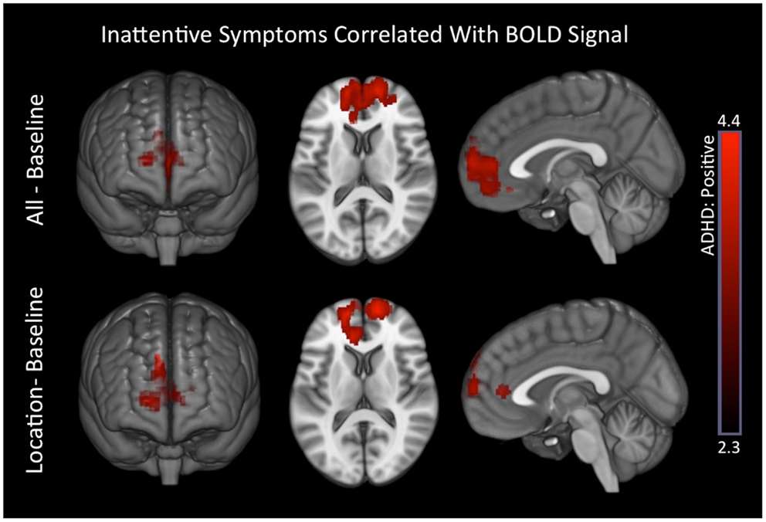
ADHD Overview Diagnosis & Treatment
Concord Comprehensive Neuropsychology Services
ADHD Brain Scan
Additional Required
Conditions
Notes:
Functional MRI study which showed unusual activity in specific brain regions for children with ADHD, frontal striatal region and also visual cortex implicated in sight in visual processing. Take away: attention is a complex process involving multiple brain systems and how the interact. There are real, measurable differences in children with ADHD’s brain’s function compared to “typical” children or controls

Slide 11
Executive Functions:
The “CEO” of the Brain is a set of mental skills that help us organize our thoughts and behaviors, and engage in goal-directed behaviors
ADHD Overview Diagnosis & Treatment
Concord Comprehensive Neuropsychology Services
Notes:
EF are series of skills that are typically impaired in students with ADHD. They are essential to our ability to marshal or natural abilities and knowledge to produce output. Break down, sequence and organize information.

Slide 12
ADHD Overview Diagnosis & Treatment
-Working Memory
A system for temporarily storing and manipulating information, which is necessary for a wide range of cognitive tasks.
Allows us to keep information “in mind” for a short period of time to use that information in our thinking
-Novel Problem Solving
Notes:
Novel problem solving: ability to flexibly reason with novel information, (engage in non-rote learning)

Slide 13
ADHD Overview Diagnosis & Treatment
ISIS
Initiate – What deserves my attention? How do I get started?
Sustain – Can I focus my attention and concentration adequately?
Inhibit – Can I “let go” and stop what I was doing when appropriate?
Shift – Can I shift focus smoothly and switch the target of my attention?

Slide 14
ADHD Overview Diagnosis & Treatment
Emotional Self Regulation
Expressing feelings appropriately
Understanding and managing feelings
Controlling impulses and gratification
Reducing Stress
Knowing the difference between feelings and actions

Slide 15
ADHD Overview Diagnosis & Treatment
Concord Comprehensive Neuropsychology Services
Comorbidities
(additional conditions)
Learning Disabilities
Social Weaknesses
Anxiety
Depression
Autism
Or more severe neurological/biological conditions
50-90% of the time, students with ADHD can also have an additional diagnosis

Slide 16
ADHD Overview Diagnosis & Treatment
Concord Comprehensive Neuropsychology Services
Treatment
What helps?
Medication: Stimulant Medications
Behavioral Intervention
Behavioral plans
Reinforcement systems
Accommodations in the Classroom
preferential seating
cueing for attention
checking for comprehension
graphic organizers
extended time on tests
separate setting to help with distractibility
preview and review of important information
assistance from an aide

Slide 17
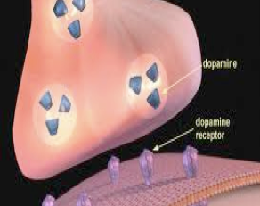
About medications
Stimulants (e.g., Ritalin) increase the availability of dopamine at the synaptic cleft
Dopamine is created in the brainstem, moves throughout the brain, but there is a breakdown in absorption in receptor sites in prefrontal areas
Stimulants inhibit reuptake into the presynaptic neuron, increasing the concentration of dopamine in the extraneuronal space
This enhances neurotransmission
Notes:
Multimodal Treatment Study for ADHD (MTA Group)
14-month Randomized Clinical Trial of Treatment Strategies for ADHD
Three questions:
How do long-term medication and behavioral treatments compare with one another?
Are there additional benefits when they are used together?
What is the effectiveness of systematic, carefully delivered treatments vs. routine community care?
Treatment Conditions
Behavioral treatment
Medication treatment
Combined treatment
Community care
Results
Medication alone had significant improvements in academics, social skills, reduction of anxiety, and parent-child relationships
The best outcome was achieved with combination of medication and behavioral interventions
A lot of under-dosing in routine community care
Retest on medications after a few months - improvements in:
visual motor precision (NEPSY)
spatial span
sustained visual attention (CPT)

Slide 18
ADHD Overview Diagnosis & Treatment
Concord Comprehensive Neuropsychology Services
Treatment
What helps?
Educational Intervention:
Organizational Tutoring to build study skills, planning and organizational abilities
Maintain organizational systems for tracking materials
Receive support through a 504 or IEP in school
Research has consistently shown that multimodal intervention:
behavioral and educational support + medication is the most effective.
-social skills group -nutrition
-counseling/therapy -sleep regulation
-educational intervention -mindfulness

Slide 19
ADHD often affects students across all aspects of all their lives + need a comprehensive approach: behavioral, educational, social, and psychopharmacological support.
ADHD Overview Diagnosis & Treatment
Concord Comprehensive Neuropsychology Services

Slide 20
ADHD Overview Diagnosis & Treatment
Concord Comprehensive Neuropsychology Services
QUESTIONS?
Notes:
Adults must meet 5 criteria, though they may present differently such as hyperactivity may appear as extreme restlessness or wearing others out with their activity.
ADD would require 3 of the previous criteria minus hyperactivity.

Slide 21
Contact
Eavan Miles-Mason, PhD
eavanmilesmasonphd@gmail.com
Renee Folsom, PhD
reneefolsomphd@gmail.com
(978) 341-4992
86 Baker Avenue Extension #301, Concord, MA 01742
www.CCNSPHD.com

